Slide 1
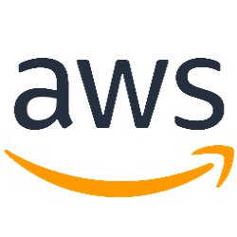
Amazon virtual private cloud (VPC) Topic: 3 Create by: MaiLT - Team 1 Date: 22/5/2019

Slide 2
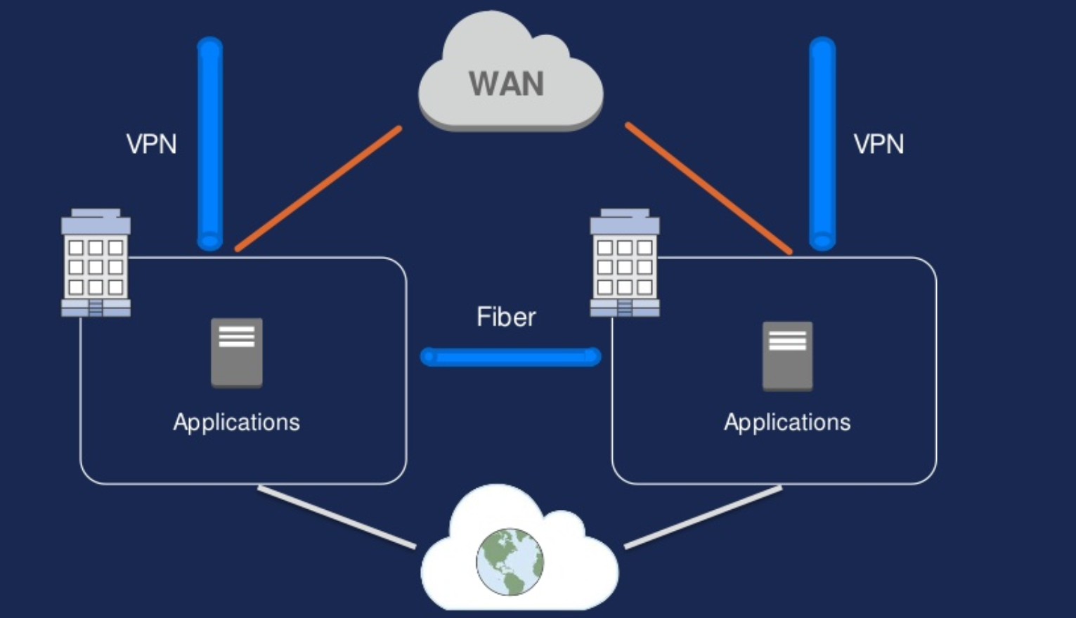
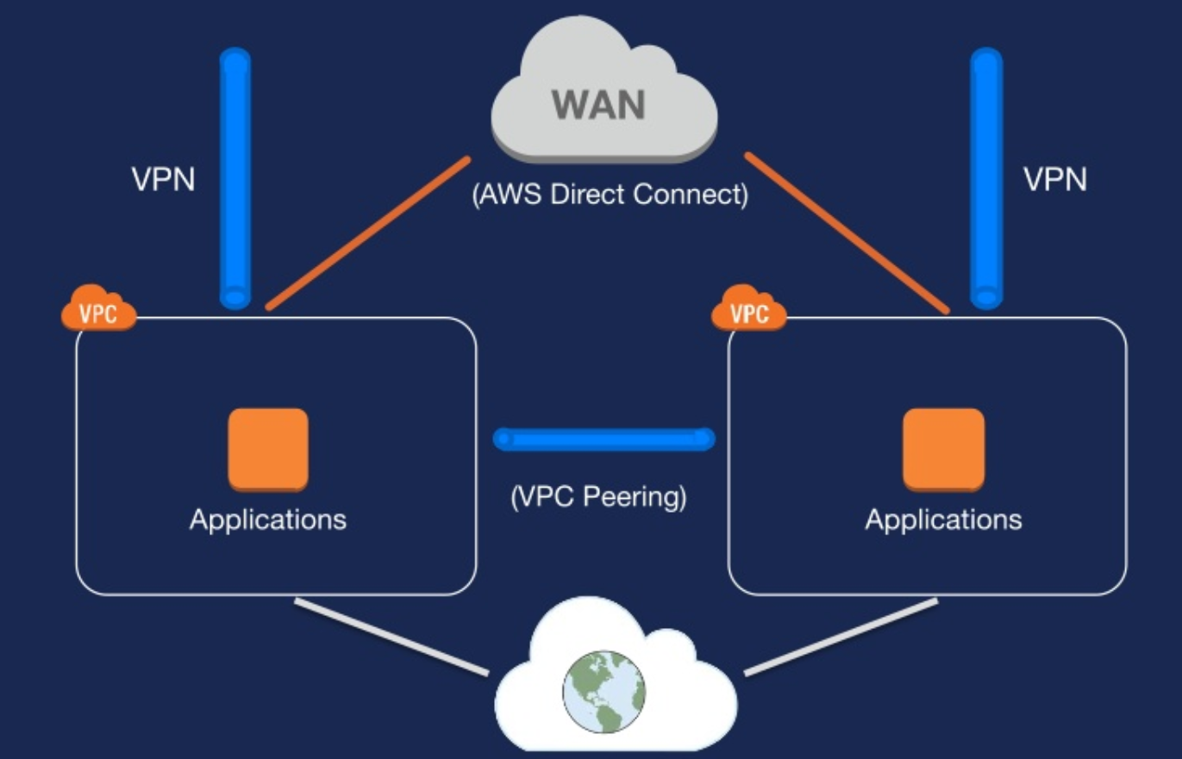
INTRODUCTION
Traditional network
AWS network

Slide 3
This topic will cover to:
Fundamentals:
VPC Overview
Picking you IP space
Subnet design
Routing and NATing
VPC Security
Advanced topic:
VPC Peering
VPC Flow Logging
VPC Endpoints
DC Connectivity:
IPsec VPN Tunnel
AWS Direct Connect

Slide 4
AWS VPC Overview

Slide 5

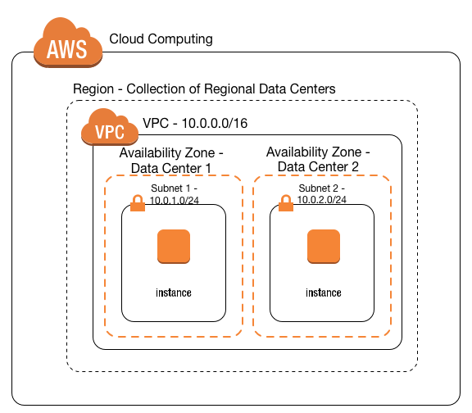
What is an Amazon Virtual private cloud (VPC)?
“A virtual network that closely resembles a traditional network that you’d operate in your own data center”

Slide 6
What is an Amazon Virtual private cloud (VPC)?
Amazon Virtual Private Cloud (Amazon VPC) enables you to launch Amazon Web Services (AWS) resources into a virtual network that you’ve defined. This virtual network closely resembles a traditional network that you’d operate in your own data center, with the benefits of using the scalable infrastructure of AWS.
You can launch your AWS resources, such as Amazon EC2 instances, into your VPC.
Your AWS resources are automatically provisioned in a ready-to-use default VPC. You can configure this VPC by adding or removing subnets, attaching network gateways, changing the default route table and modifying the network ACLs.
You can choose to create additional VPCs by going to the Amazon VPC page in the AWS Management Console and selecting "Start VPC Wizard".

Slide 7
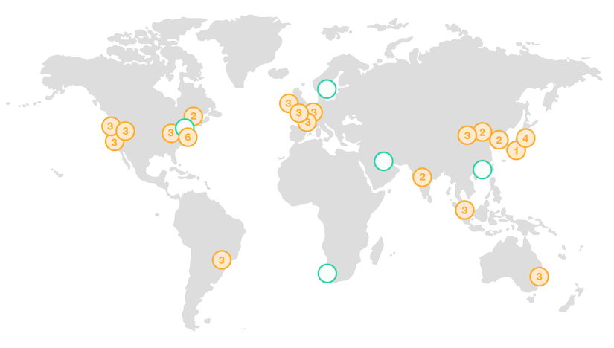
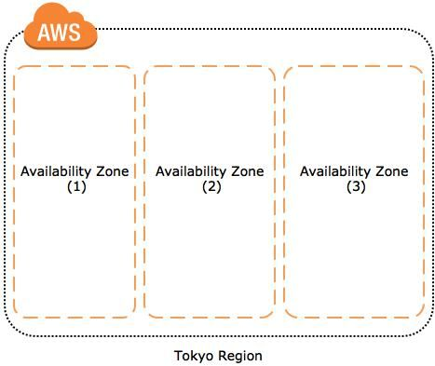
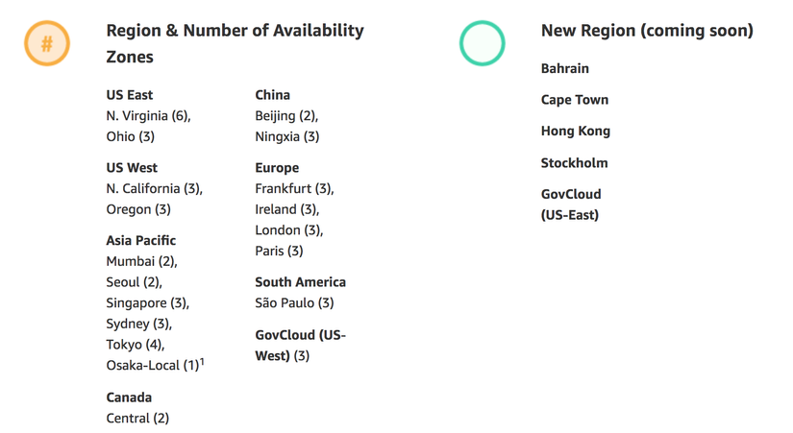
Some basic concepts
Region
AZ (Availibility Zone)

Slide 8
VPC components
VPC
Subnet
Internet Gateway
NAT Gateway
Peering Connection
VPC Endpoint
Egress-only Internet Gateway
Elastic IP Addresses
Security
Virtual Private Network (VPN)

Slide 9
VPC

Slide 10
VPC
A Virtual Private Cloud: is a virtual network dedicated to your AWS account. It is logically isolated from other virtual networks in the AWS Cloud. You can launch your AWS resources, such as Amazon EC2 instances, into your VPC. You can specify an IP address range for the VPC, add subnets, associate security groups, and configure route tables.
When you create a VPC, you must specify an IPv4 CIDR block for the VPC. The allowed block size is between a /16 netmask (65,536 IP addresses) and /28 netmask (16 IP addresses). After you've created your VPC, you can associate secondary CIDR blocks with the VPC.

Slide 11
Subnet

Slide 12
Subnet
Subnet: is a range of IP addresses in your VPC. You can launch AWS resources into a specified subnet. Use a public subnet for resources that must be connected to the internet, and a private subnet for resources that won't be connected to the internet.
The CIDR block of a subnet can be the same as the CIDR block for the VPC (for a single subnet in the VPC), or a subset of the CIDR block for the VPC (for multiple subnets)
Subnet Routing: each subnet must be associated with a route table, which specifies the allowed routes for outbound traffic leaving the subnet. Every subnet that you create is automatically associated with the main route table for the VPC.
Subnet Security: each subnet must be associated with a network ACL. Every subnet that you create is automatically associated with the VPC's default network ACL.

Slide 13

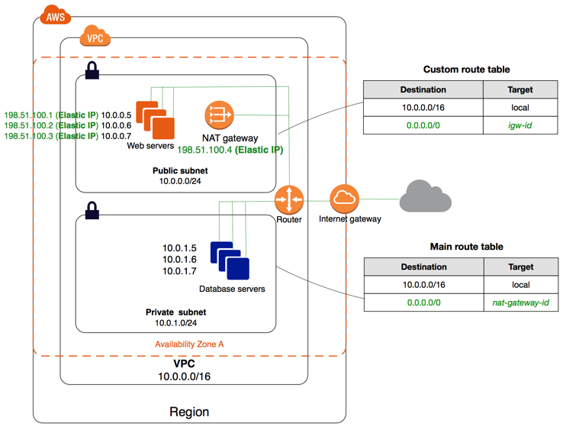
Public/Private Subnet

Slide 14
VPC subnet recommendations
/16 VPC (64K IPv4 addresses)
/24 subnets (251 IPv4 addresses)
One subnet per Availability Zone
For IPv6:
/56 Allocated per VPC (Lots of addresses)
/64 subnets (256 Subnets)

Slide 15
Internet Gateway

Slide 16
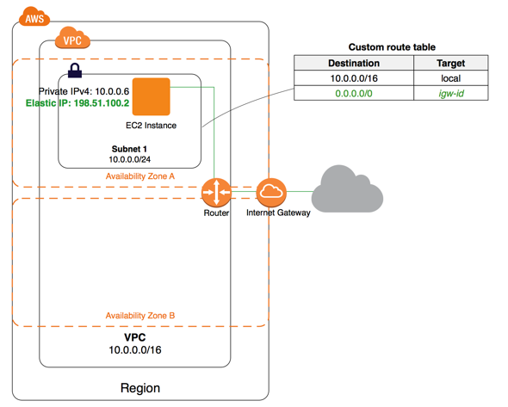
Internet Gateway
The Amazon VPC side of a connection to the public Internet.

Slide 17
NAT Gateway

Slide 18
NAT Gateway
Network address translation (NAT) gateway is used to enable instances in a private subnet to connect to the internet or other AWS services, but prevent the internet from initiating a connection with those instances

Slide 19
Peering Connection

Slide 20
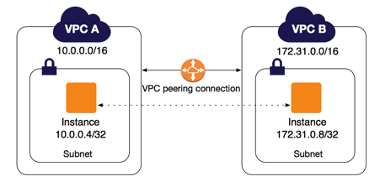
Peering Connection
A peering connection enables you to route traffic via private IP addresses between two peered VPCs.

Slide 21
VPC Endpoint

Slide 22
VPC Endpoint
Enables private connectivity to services hosted in AWS, from within your VPC without using an Internet Gateway, VPN, Network Address Translation (NAT) devices, or firewall proxies. Endpoints are virtual devices. There are two types of VPC endpoints: interface endpoints and gateway endpoints. Create the type of VPC endpoint required by the supported service.

Slide 23
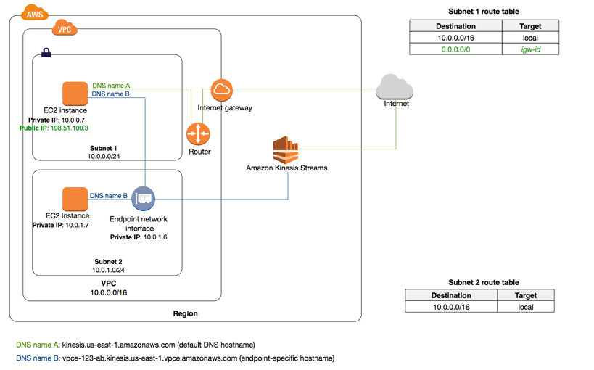
An interface endpoint is an elastic network interface with a private IP address that serves as an entry point for traffic destined to a supported service.

Slide 24
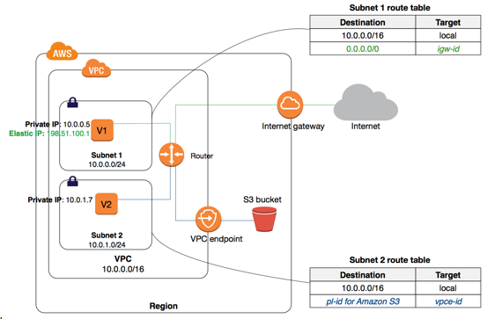
A gateway endpoint is a gateway that is a target for a specified route in your route table, used for traffic destined to a supported AWS service.

Slide 25
Egress-only Internet Gateway

Slide 26
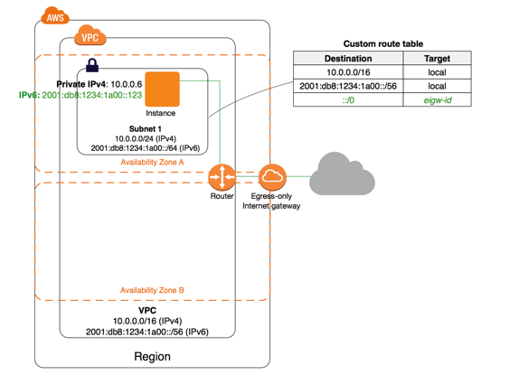
Egress-only Internet Gateway
A stateful gateway to provide egress only access for IPv6 traffic from the VPC to the Internet (that allows outbound communication over IPv6 from instances in your VPC to the Internet, and prevents the Internet from initiating an IPv6 connection with your instances.)

Slide 27
Elastic IP Addresses

Slide 28
Elastic IP Addresses
Elastic IP Addresses: is a static, public IPv4 address designed for dynamic cloud computing. You can associate an Elastic IP address with any instance or network interface for any VPC in your account. With an Elastic IP address, you can mask the failure of an instance by rapidly remapping the address to another instance in your VPC (the advantage of associating the Elastic IP address with the network interface instead of directly with the instance is that you can move all the attributes of the network interface from one instance to another in a single step)

Slide 29
Security

Slide 30
Security
AWS provides two features that you can use to increase security in your VPC: security groups and network ACLs.
Security groups control inbound and outbound traffic for your instances
Network ACLs is an optional layer of security for your VPC that acts as a firewall for controlling inbound and outbound traffic for your subnets (a optional layer of security for your VPC that acts as a firewall)

Slide 31
Virtual Private Network (VPN)

Slide 32
VPN
Create Customer Gateway: Specify the Internet-routable IP address for your gateway's external interface.
Virtual private gateway: The Amazon VPC side of a VPN connection.
Site-to-site VPN Connections: Mapping the virtual private gateway and customer gateway that you would like to connect via a VPN connection.

Slide 33

Scenarios and Examples

Slide 34
Scenarios and Examples
Scenario 1: VPC with a Single Public Subnet
Scenario 2: VPC with Public and Private Subnets (NAT)
Scenario 3: VPC with Public and Private Subnets and AWS Site-to-Site VPN Access
Scenario 4: VPC with a Private Subnet Only and AWS Site-to-Site VPN Access

Slide 35
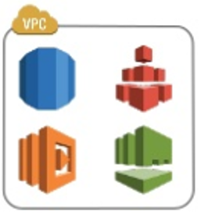
Place your screenshot here
Best practice for in VPC-AWS services.
Many AWS services support running in –VPC.
Use security groups for Least-Privilege network access.
For best avaibility, use multiple Avaibility Zones.
Ex:
Multi-zone RDS deployments
Use a zonal mount point for EFS access

Slide 36
THANKS!
Any questions?
Connect to github repository to read more detail: https://github.com/hueanmy/AWS-LEARNING

